Slide 1
Flow Past Immersed Bodies
By
Dr. S. S, Baral

Slide 2
Outline
Drag and drag coefficient
Flow through beds of solids
Motion of particles through fluids
Fluidization

Slide 3
Introduction
Solid object/body surrounded by viscous fluid
Body experiences net force and it depends on
Relative velocity
Body size and shape
Fluid properties
Net force
Drag - parallel to the direction of motion
Lift – perpendicular to the direction of motion

Slide 4
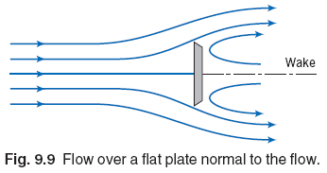
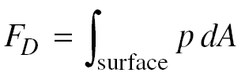
Drag
Force in the direction of flow exerted by fluid on the solid.
Form drag
Drag from the local pressure

Slide 5

Drag
Wall drag
Drag from the wall shear stress
There is no net drag for incompressible, inviscid flow (potential flow)

Slide 6
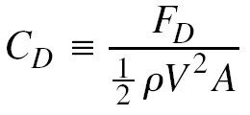

Drag coefficient
Similar to skin friction coefficient (for flat surfaces)
It is used for immersed solids
Ratio of drag force per unit projected area to the product of velocity head and density
For incompressible fluid

Slide 7
Drag coefficient
For compressible fluids
C_{D} = f (Re, M)
Drag coefficients of typical shapes (Fig. 7.3)
Spheres
Disks
Cylinders
Assumption – Axis of cylinder and face of disk are perpendicular to the direction of flow

Slide 8
Drag coefficient
Stoke’s law
For low Re, drag force for a sphere (Re < 1)
Drag coefficient
C_{D}= 24/Re_{p}
Type of flow treated by this law → creeping flow

Slide 9
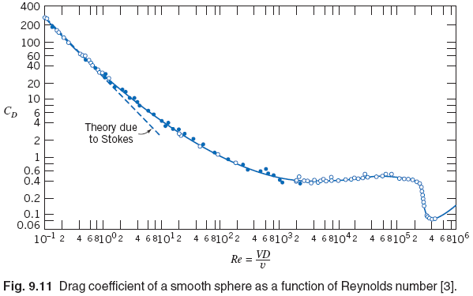
Drag coefficient

Slide 10
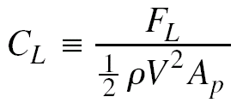
Lift
Component of fluid force perpendicular to the fluid motion (Mostly applies to airfoils)
Lift coefficient
Airfoils
Lift and drag coefficients are function of Re and angle of attack (angle between chord and free-stream velocity vector)

Slide 11
Flow through beds of solids
Objective → To study the flow behavior of single fluid phase through a column of stationary solid particles
Resistance to the flow of fluid (leads to pressure drop) → function of total drag on solid boundaries
Calculation of this pressure drop (total drag)
Need to take tortuous channels through the bed into consideration

Slide 12
Flow through beds of solids – Important parameters
Surface to Volume ratio
Sphericity
Porosity (void fraction)
Equivalent Channel Diameter
Superficial velocity
Average velocity

Slide 13
Calculation of pressure drop
Pressure drop depend on average velocity and channel diameter
Average velocity and channel diameter can be expressed in terms of measurable parameters (superficial velocity, diameter of particle, porosity)
Low Re
Hagen-Poiseuille equation

Slide 14
Calculation of pressure drop
Kozeny-Carman equation
Applicable for very low Re (Re_{p} <1.0)
Darcy’s law
Used to describe the flow of liquids through porous media
Burke-Plummer equation
Applicable for high Re (Re_{p}>1000)
Ergun equation
Effect of void fraction on pressure drop

Slide 15
Mixture of particles in the bed
Ergun equation can be used to determine the pressure drop
Particle diameter will be replaced by surface mean diameter of the mixture.

Slide 16
Motion of particles through fluids
Mechanics of particle motion
Balance of forces
External force
Buoyant force
Drag force
One dimensional motion of particle through fluid
Generalized equation
Motion from gravitational force
Motion in a centrifugal field

Slide 17
Motion of particles through fluids
Terminal velocity
Maximum attainable velocity by a particle moving through the fluid
For gravitational settling
In motion from centrifugal force
Drag coefficient (Fig. 7.7)
Curve applicable under certain restrictions – like solid particle, particle is far from other particles and wall, moving with terminal velocity

Slide 18
Motion of particles through fluids
Free settling/Hindered settling
Drag coefficient in hindered settling is greater than in free settling
Brownian movement of the particle
Very small particles (2 to 3 micrometer size)
Tend to suppress the effect of gravity and settling does not occur
Application of centrifugal force reduces the effect of brownian movement

Slide 19
Motion of spherical particles
Generalized expression for terminal velocity
Low Re (Re <1)
Drag coefficient
Drag force
Terminal velocity → Stoke’s law
For high Re (1000 < Re < 200,000)
Drag coefficient
Drag force
Terminal velocity → Newton’s law

Slide 20
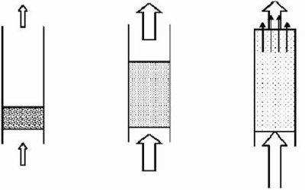
Fluidization
It is corresponding to the condition of fully suspended particles (as suspension behaves as dense fluid)

Slide 21
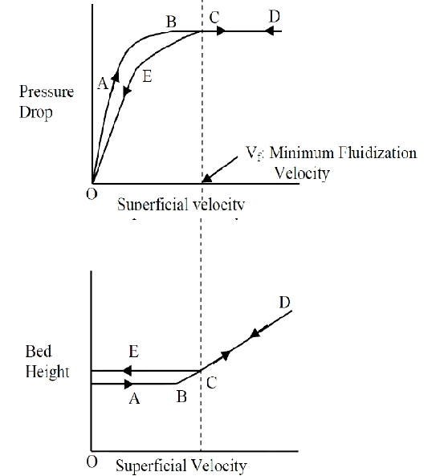
Fluidization
Important design
parameters
Minimum fluidization
velocity
Bed expansion of
fluidization
Pressure variation in
bed

Slide 22
Minimum fluidization velocity
Can be obtained by setting pressure drop across the bed equal to the weight of the bed per unit area of cross section
Expression for minimum fluidization velocity
Ergun equation → quadratic equation
Kozeny-Carman (Low Re)
V_{OM} is proportional to D_{p}²
Burke-Plummer equation (High Re)
V_{OM} is proportional to D_{p}^{0.5}

Slide 23
Terminal velocity and Minimum fluidization velocity
For low Re (small particles) – Stoke’s law regime
Both vary with D_{p}² and density difference (particle and fluid) and viscosity
Their ratio depends only on void fraction at minimum fluidization velocity and its high (Approximately 50 for spherical particles)
For high Re (coarse particles) – Newton’s law regime
Low ratio
More entrainment

Slide 24
Types of fluidization
Particulate fluidization
Particles move farther apart and their motion becomes more vigorous as velocity is increased but average density of the bed at a given velocity is same in all sections
E.g. Sand particles in water
Bubbling fluidization/Aggregative fluidization
Gases pass through the solid as bubbles or voids
E.g. solids fluidized with air

Slide 25
Expansion of fluidized beds
Particulate fluidization
Relation between length of the bed and porosity (void fraction)
For large particles
Empirical correlation for relating superficial velocity to the porosity
Data for glass beads is given in Fig. 7.13, 7.14, 7.15

Slide 26
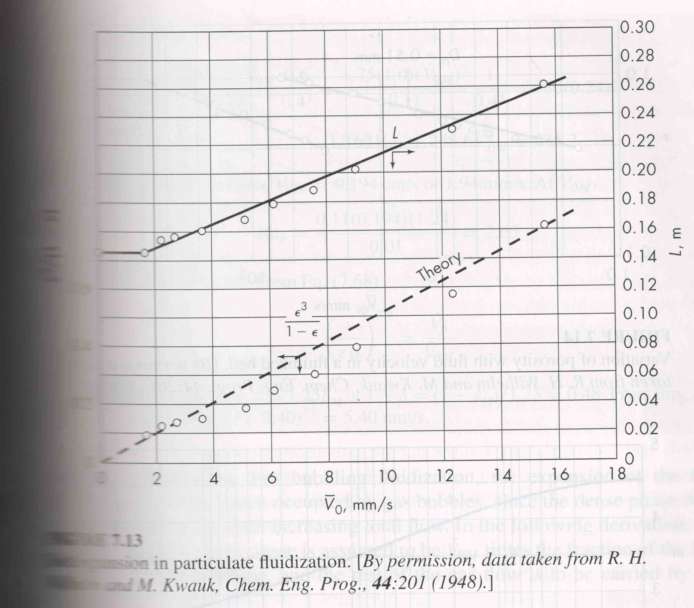
Bed expansion of particulate fluidization

Slide 27
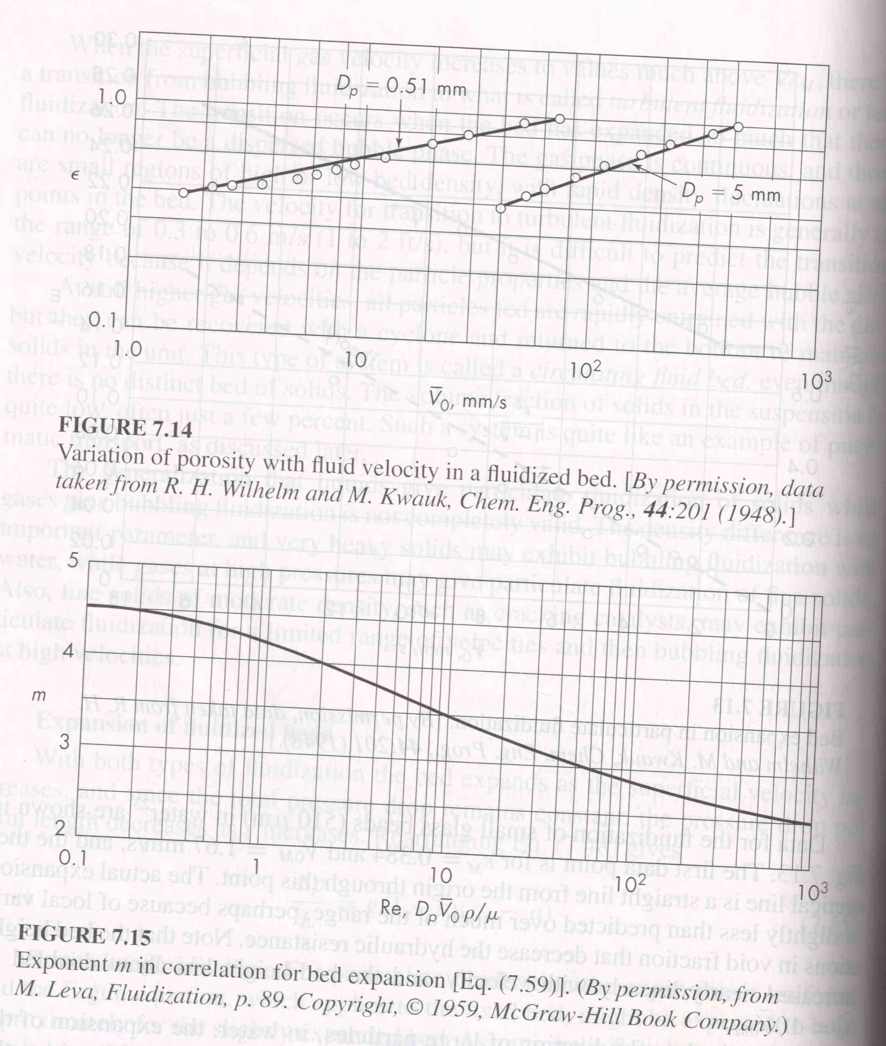

Slide 28
Application of fluidization
Fluid catalytic cracking
Mainly in regenerating the catalyst
Catalytic processes
Synthesis of acrylonitrile
Solid gas reactions
Fluidized bed combustion of coal

Slide 29
Advantages / Disadvantages of fluidization
Advantages
Solid is vigorously agitated by the fluid and there is practically no temperature gradients
Provides high heat transfer rates to the walls of the bed
Easy to transport solids
Disadvantages
Uneven contacting of gas and solids
Erosion of vessel internal parts
Attrition of solid particles

